Slide 1
Cairo university
Faculty of computers and artificial intelligence
“Developing a website of Egyptian tourism using OR”.
Travel with me in Egypt
Supervised by
Prof/Dr : Mohamed Saleh
Dr : Ghada Tolan
July 2021

Slide 2
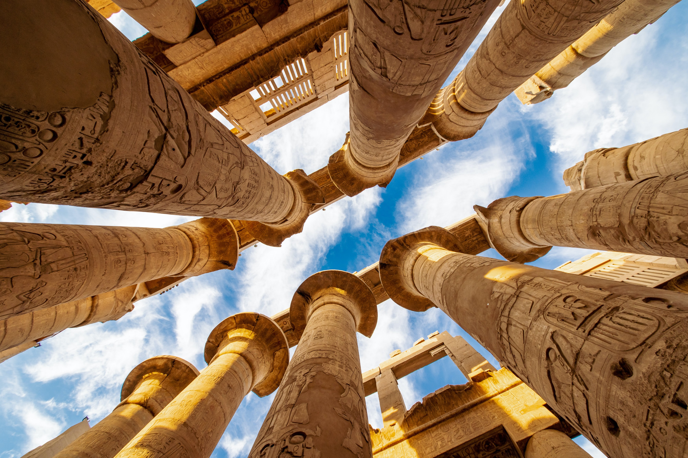
Travel with
me in
Egypt

Slide 3
Project team members
Name | ID
Taha Mahmoud Taha | 20170135
Mohamed Ahmed Abdallah | 20170214
Mariam Abdelkader Wfa | 20170281
Naglaa Sayed Hashem | 20170312

Slide 4
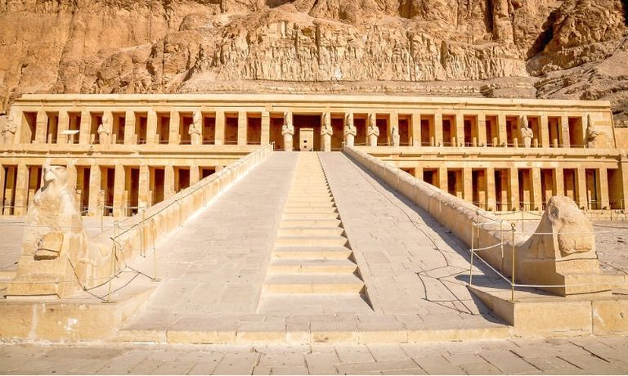
Agenda
Abstract
Tourism in Egypt
Problem statement
Background
Problems with existing systems
Website Objectives
Survey Form of our new features
Collecting Users’ ratings

Slide 5
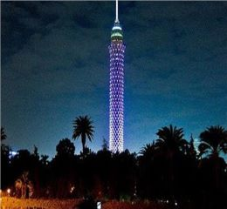
Agenda cont.
9. Methodology
10. Mathematical Model
11. Software System
12. Sequence of Website Flow
13. User Interface
14. Functions Explanation and 15. running Program
16. Future Work
17. Conclusion

Slide 6
Introduction
The tourism sector is of utmost importance for any country because of its positive impact on building and promoting the economy. and for this our project is to establish a tourist site at the highest level of services to increase the attraction of tourists.

Slide 7
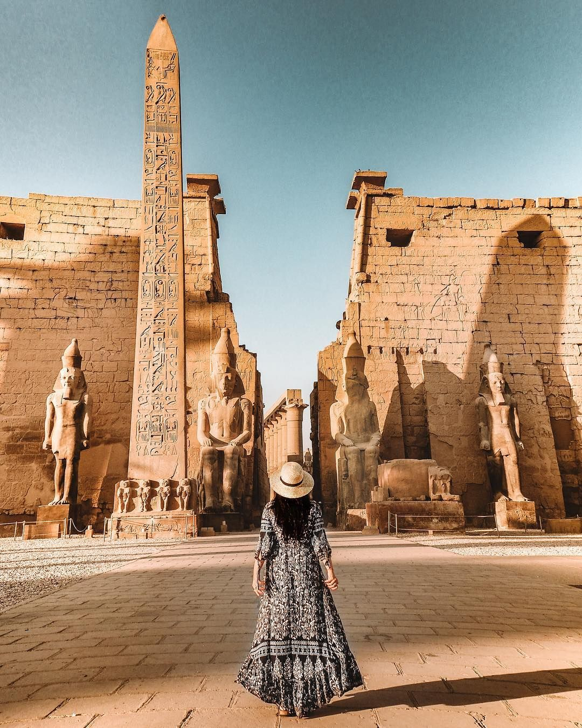
Tourism in Egypt
-Egypt has all the ingredients that made it a distinguished and wonderful tourist country, as it possesses a large number of monuments, as the city of Luxor alone contains more than two-thirds of the world’s monuments. And pure fresh water, and it also contains Pharaonic monuments that have no parallel in the whole world. It also contains Islamic and Coptic antiquities, in addition to its moderate atmosphere in summer and winter.
-Tourism is one of the main sectors which Egyptian income depends on ,So we are in need of make it easier for tourists to make a reservation online specially in covid-19 situation.

Slide 8
Problem statement
-Due to the spread of Covid 19, the tourism sector has been affected greatly, which has negatively
affected the Egyptian economy, and for this our goal of the project is to promote tourism in a safe
way that does not increase the spread of the Corona virus and thus increase tourism activity again
that will help Egypt economically.
-After searching we found that there’s no Egyptian website that provide a complete visit for tourists.
-We aim to comprised many features from different websites in one website that make it easy for
tourists to use it which lead to tourism Promotion.
-one of our main objectives is to use “OR” tools in analyzing and developing the project to apply
what we study in a real life application.

Slide 9





Background

Slide 10
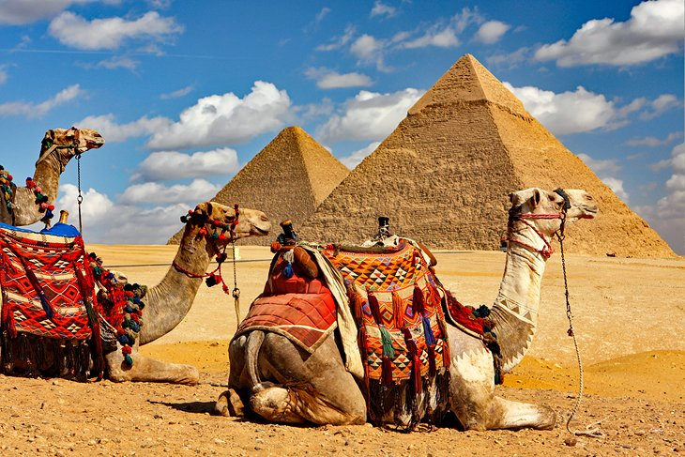
Problems with existing systems
Some of these website is just a hotel reservation website.
Other websites which provide a trips make users search for a trip by place name or government name which tourists don’t know th names.
Website objectives (How can we provide a solution?)
We comprised features from different websites in our website like user can book a hotel , show tourism places information and rate the trip .In addition to we offer a complete trip.
Website will also allow users to filter trips by its type.
Ease of use.
Has high level of interaction and quick response.

Slide 11
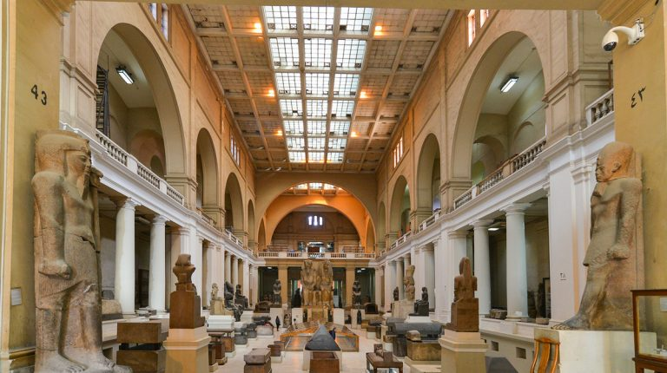
Website objectives conts.
Website will have some new features as:
filter by price or number of places or price and number of places at the same time.
sorting trips by date.
Sorting trips by trip quality (low to high) and vice versa.
4. Strong security in signup and login.

Slide 12
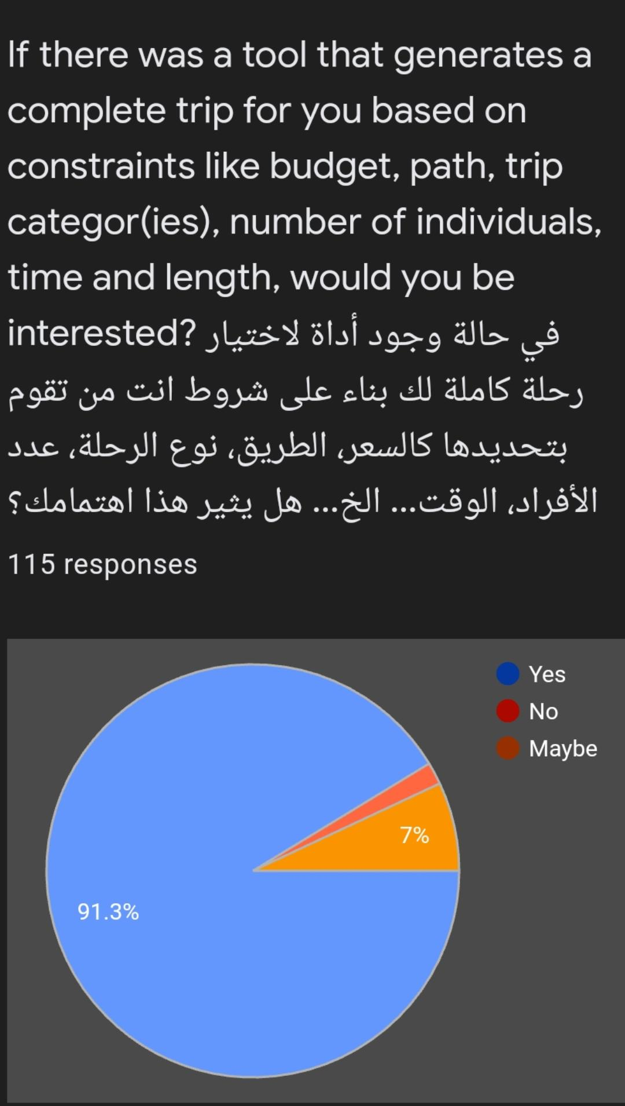
Survey form of our new features
We‘ve made a Google forms survey asking for user’s opinion on our website’s idea and their rating for specific touring places they went to.

Slide 13
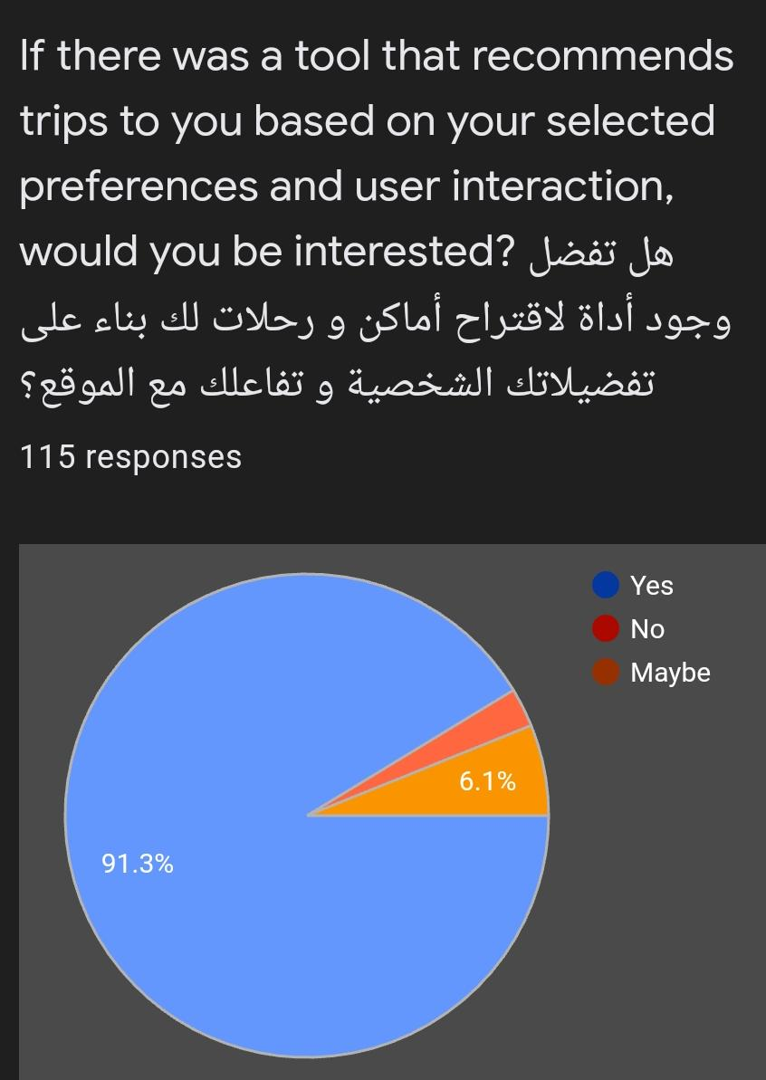
Survey form of our new features
We‘ve made a Google forms survey asking for user’s opinion on our website’s idea and their rating for specific touring places they went to.

Slide 14
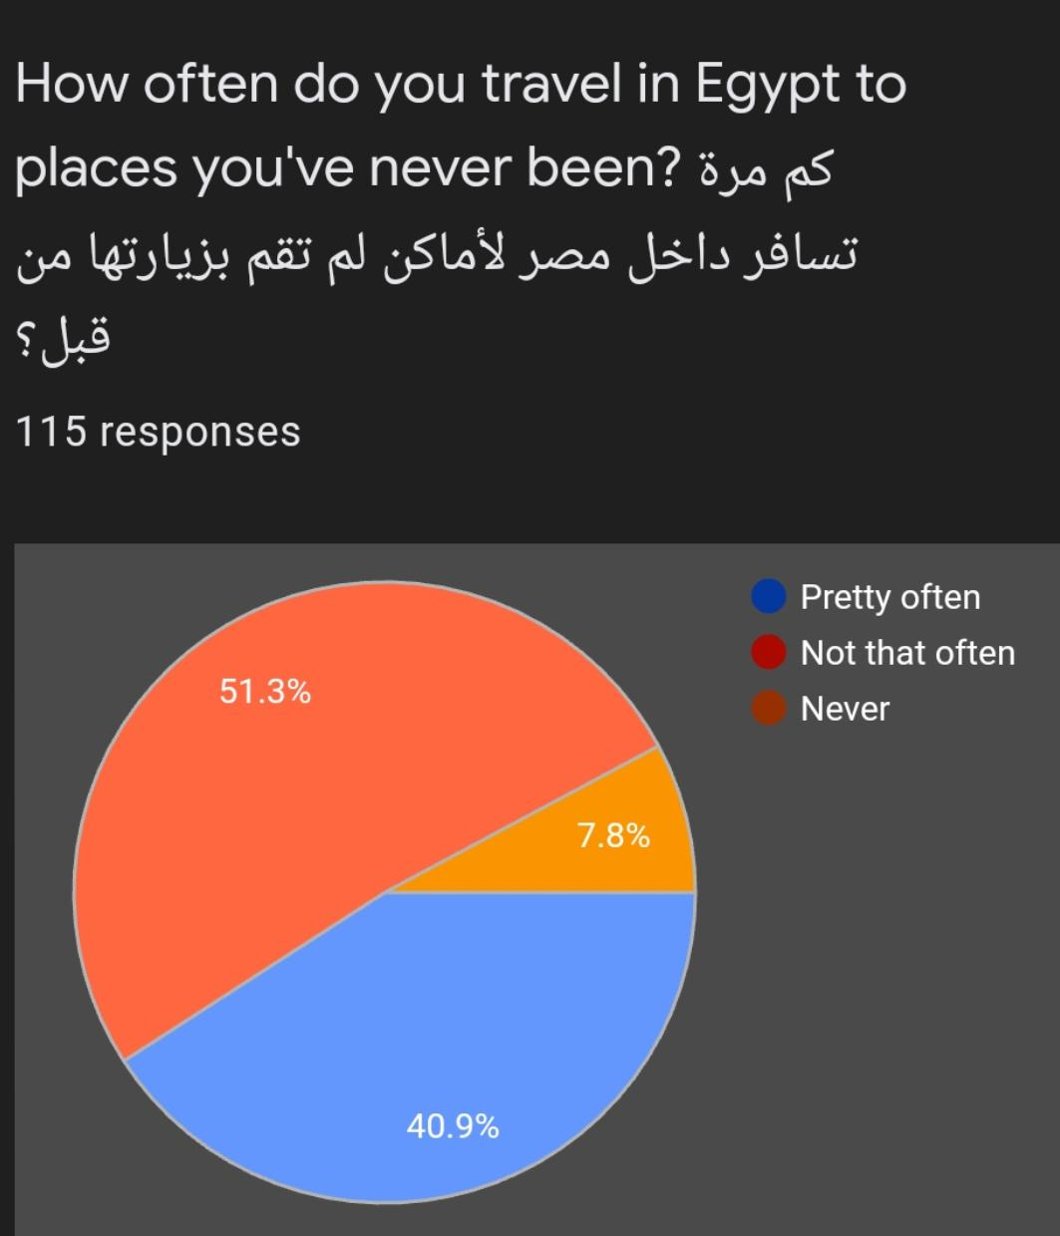
Survey form of our new features
We‘ve made a Google forms survey asking for user’s opinion on our website’s idea and their rating for specific touring places they went to.

Slide 15
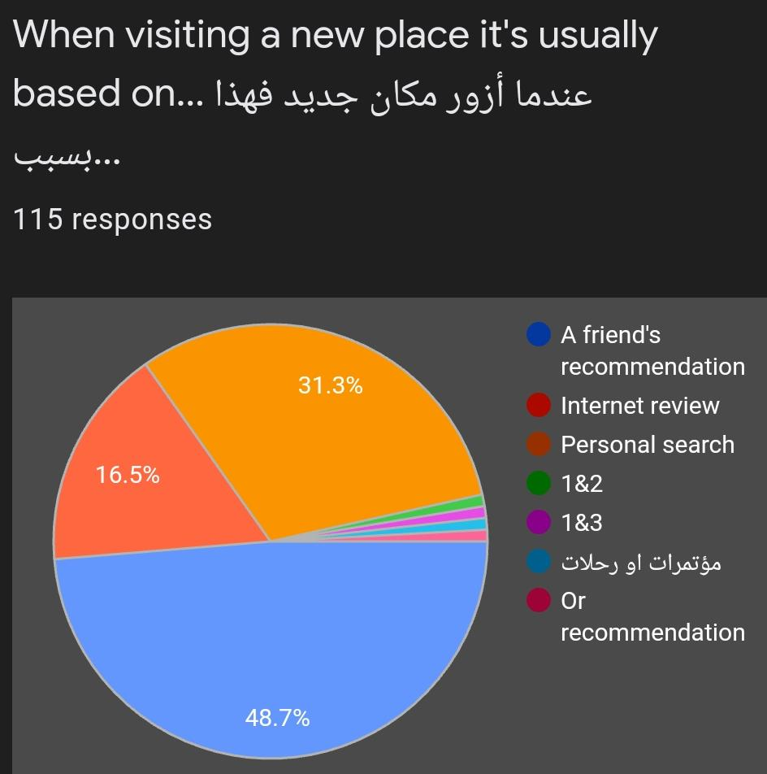
Survey form of our new features
We‘ve made a Google forms survey asking for user’s opinion on our website’s idea and their rating for specific touring places they went to.

Slide 16
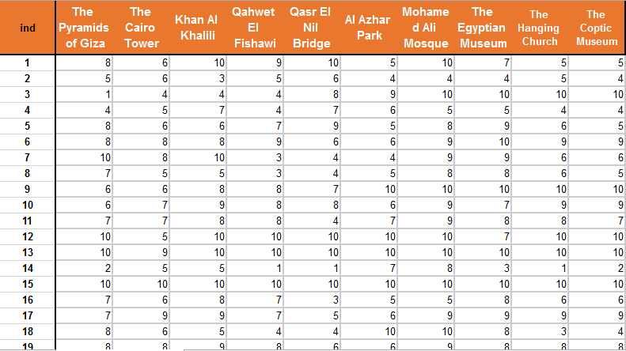
Collecting Users’ ratings of 10 random Places
Deployment of these data will be later revealed in future work.

Slide 17
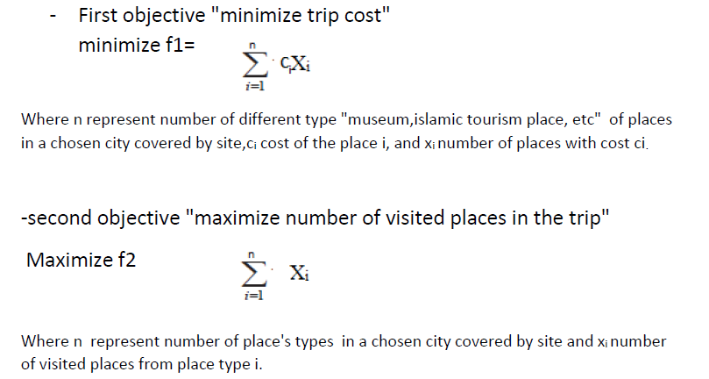
methodology
One of our main functions in implementation is to use “OR” goal programming tool to make a function that user can filter a trips with two filters “goals” minimize the trip cost and maximize number of visited places.
Mathematical Model:
Decision variables: Xi represents number of places from place type i.
tij represents time taken in place I in trip j.
Pj represents number of places at trip j.
Objective Functions:

Slide 18
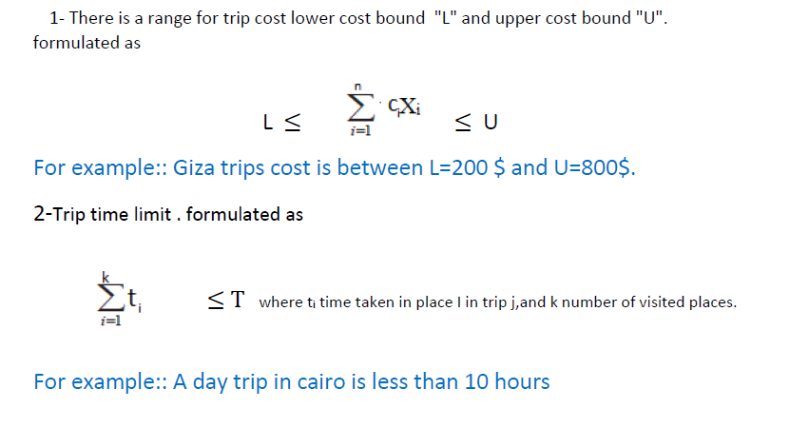
Mathematical model conts.
_ under constraints:

Slide 19

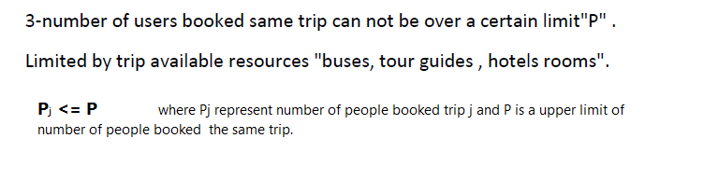
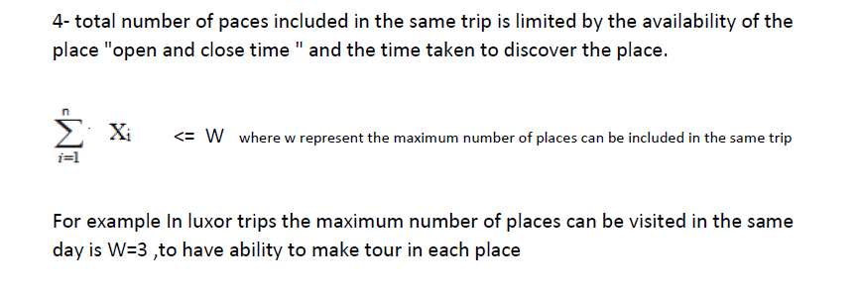
Mathematical model conts.

Slide 20
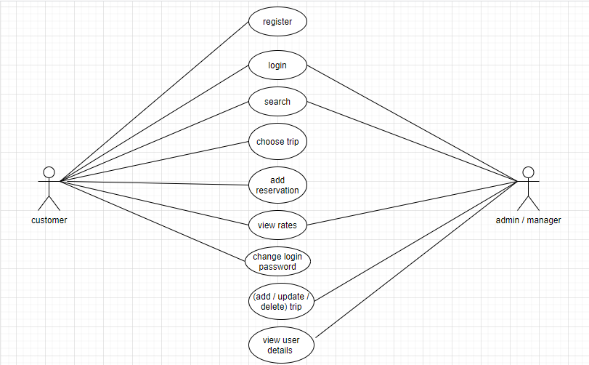
Software system
Use Case

Slide 21
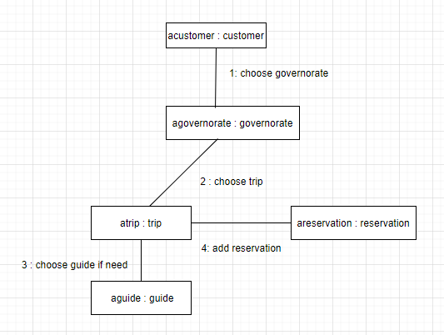
Process view

Slide 22
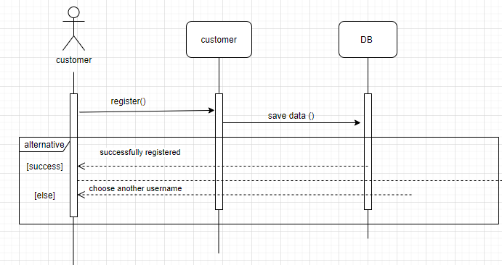
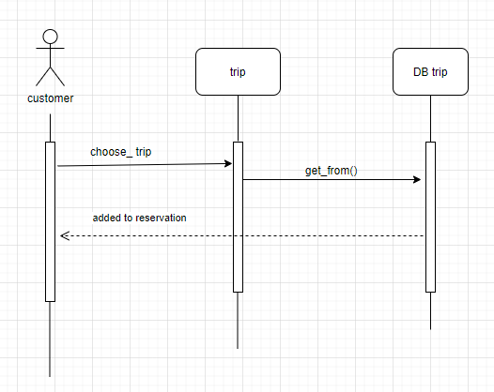
UML sequence/communication diagram

Slide 23
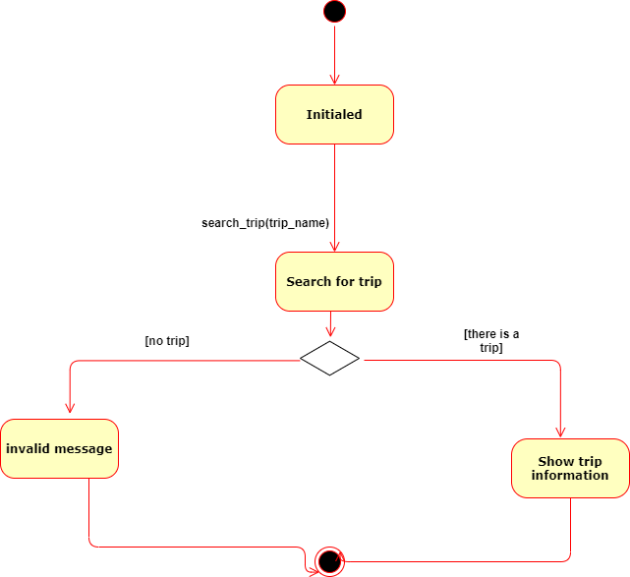
State transition diagram

Slide 24
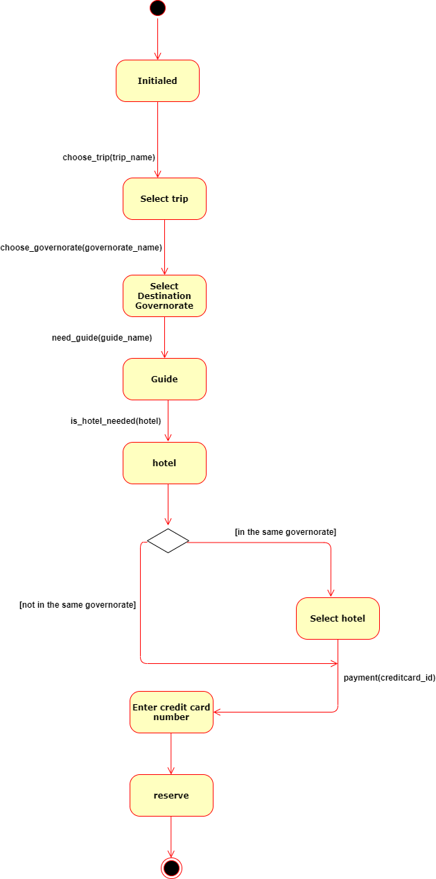

Slide 25
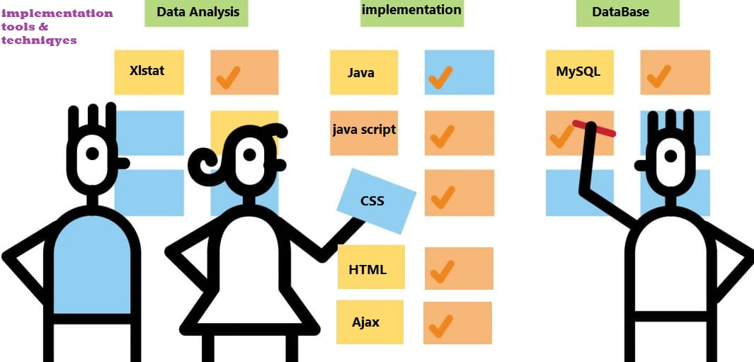
Software tools and programming languages

Slide 26
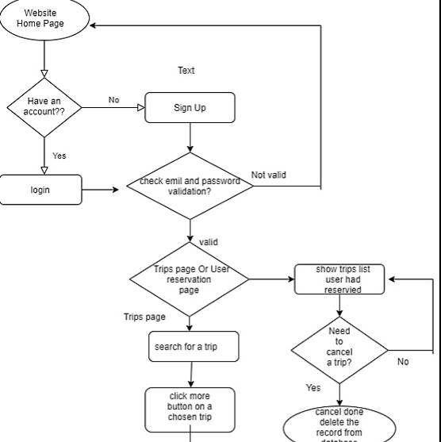
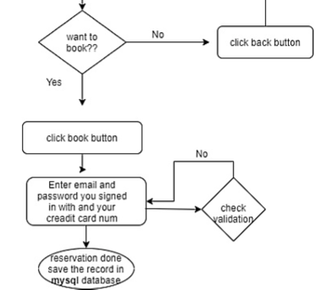
Sequence of website flow

Slide 27
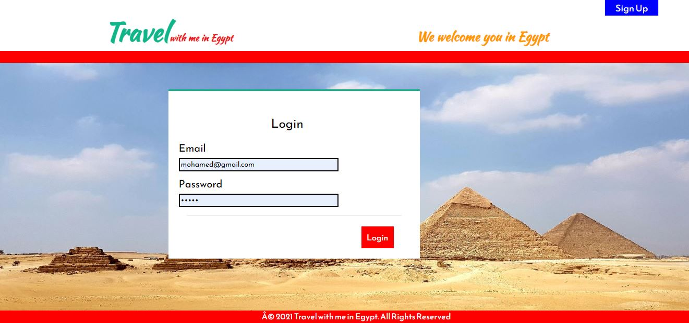
User interface

Slide 28
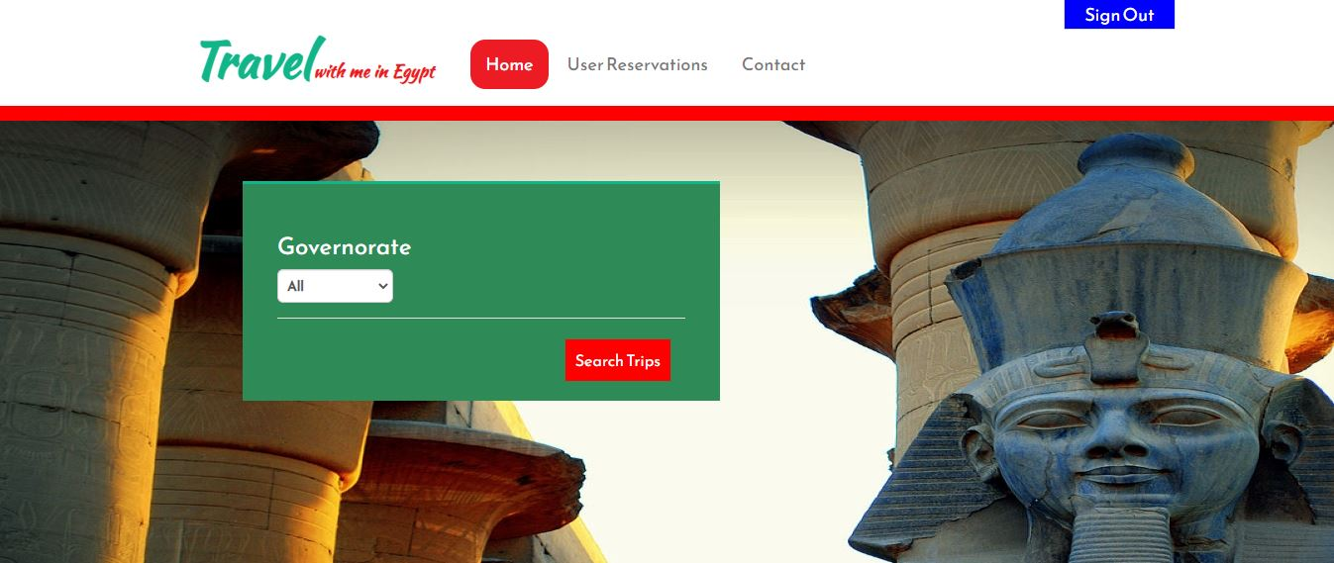
User interface

Slide 29
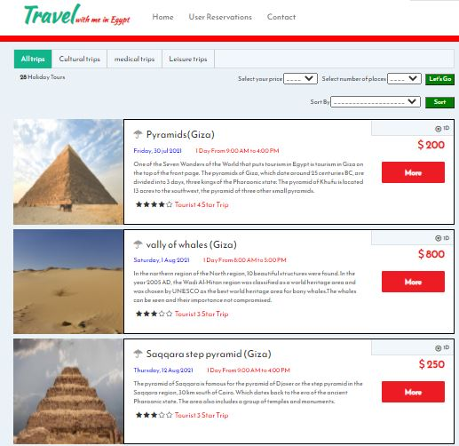
User interface

Slide 30
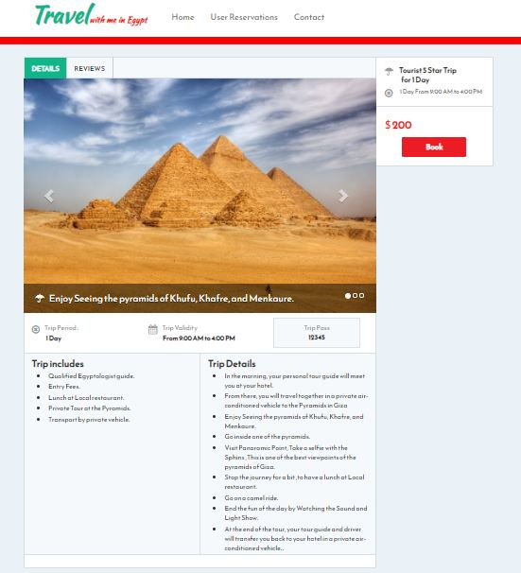
User interface

Slide 31
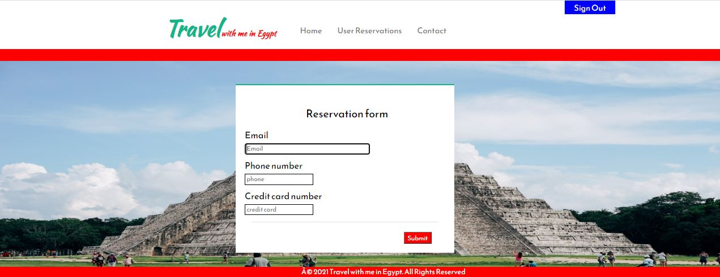
User interface

Slide 32
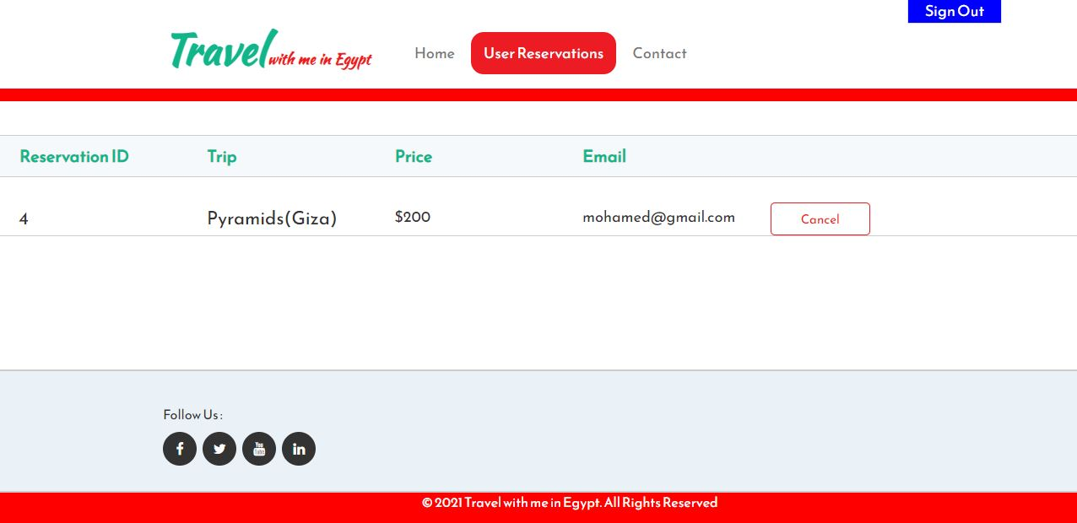
User interface

Slide 33


Slide 34
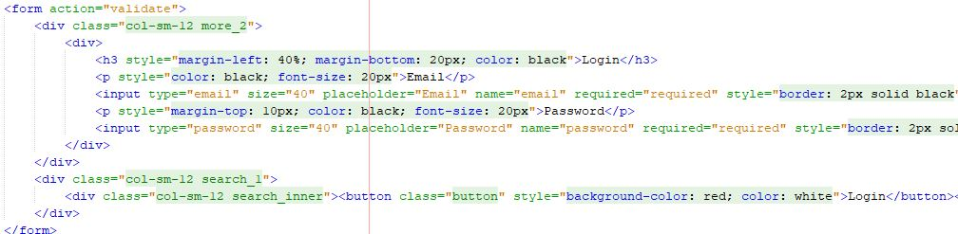
Functions explanation and validation and running program
Login
- In this function the user enter his email and password in login.jsp.

Slide 35
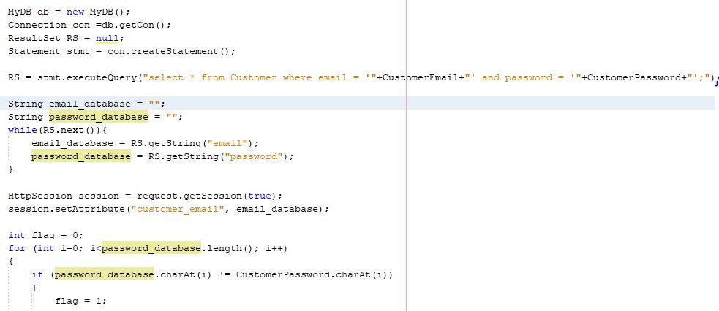
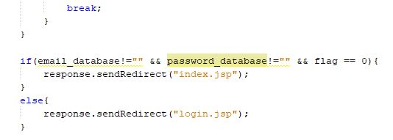
Then we check in page called validate if the data is correct by comparing it with the
data in MYSQL.

Slide 36
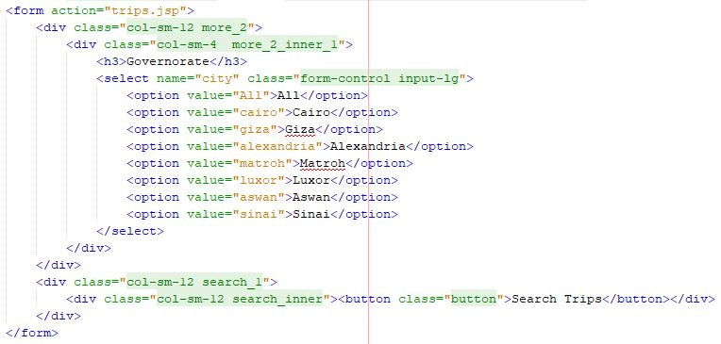
Search trip by city
- In this function we propose a list of cities to user so he can choose trips in the city he want or he can choose all cities in page index.jsp then the data sent to page trips.jsp to make operations on this choice to show the right trips.

Slide 37
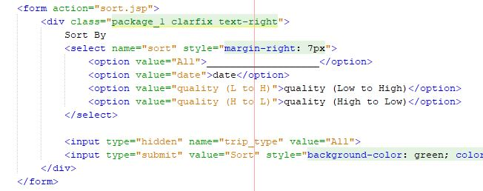
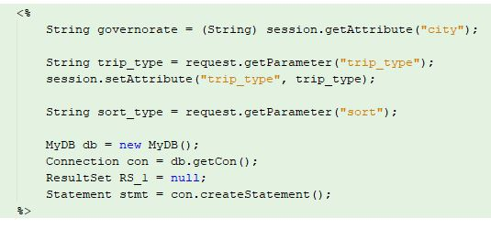
Sort trip by date
- In this function the user can sort trips by date from a button in page trips.jsp, this selection is gone to page sort.jsp that get data from MYSQL database and sort them.
sort.jsp

Slide 38
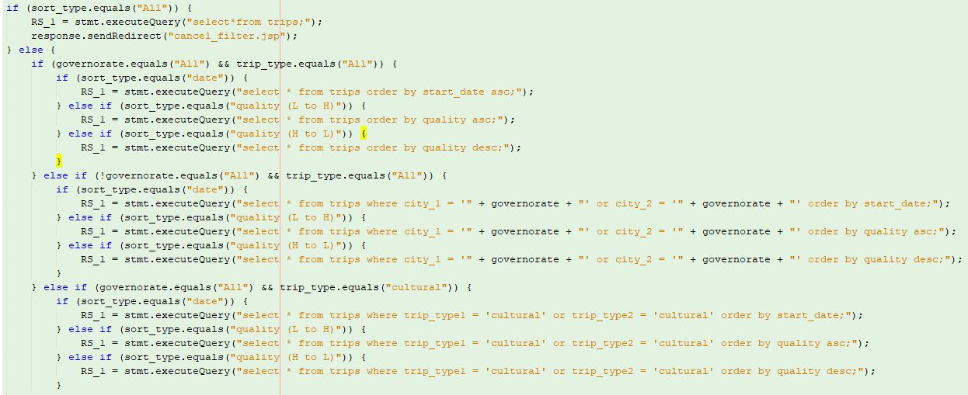

Slide 39
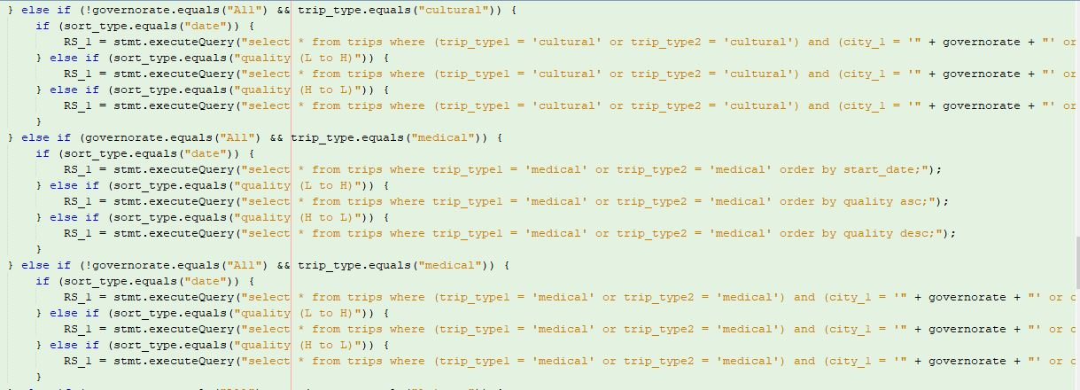
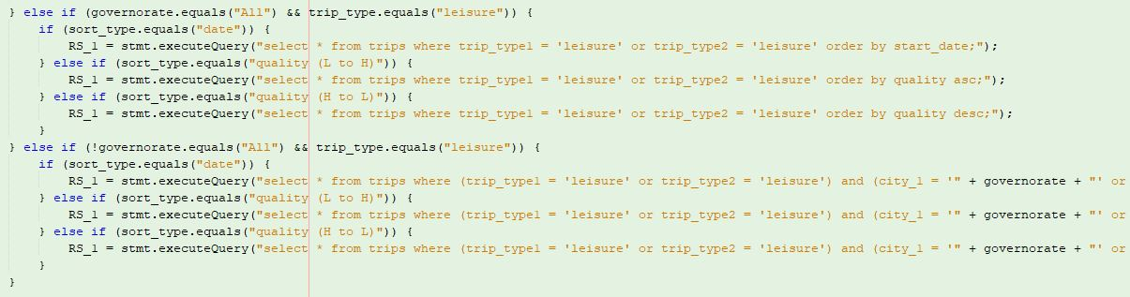

Slide 40
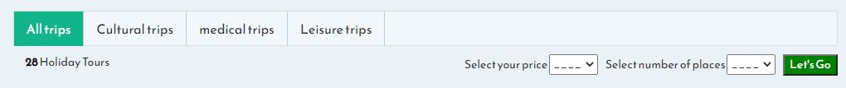
Search trips by price and number of places (The most important or function in our website and not found in all other websites)
- In this function the user can search trips by price only or number of places only or price and number of places at the same time by providing 2 lists (price and number of places) with one button called let’s go in page trips.jsp.
trips.jsp

Slide 41
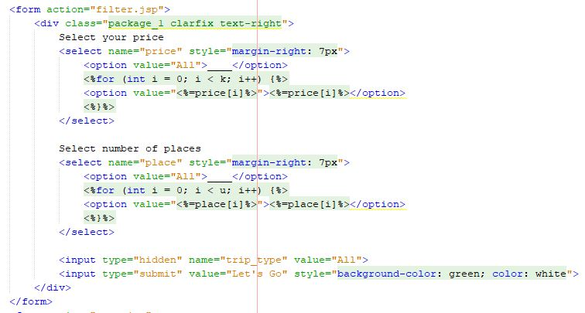
trips.jsp

Slide 42
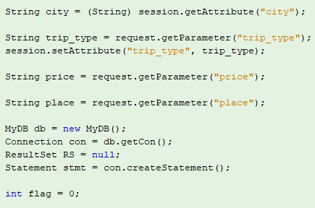
-then the choice of user is gone to page filter.jsp to make operations on this choice and show the right results.
Filter.jsp

Slide 43
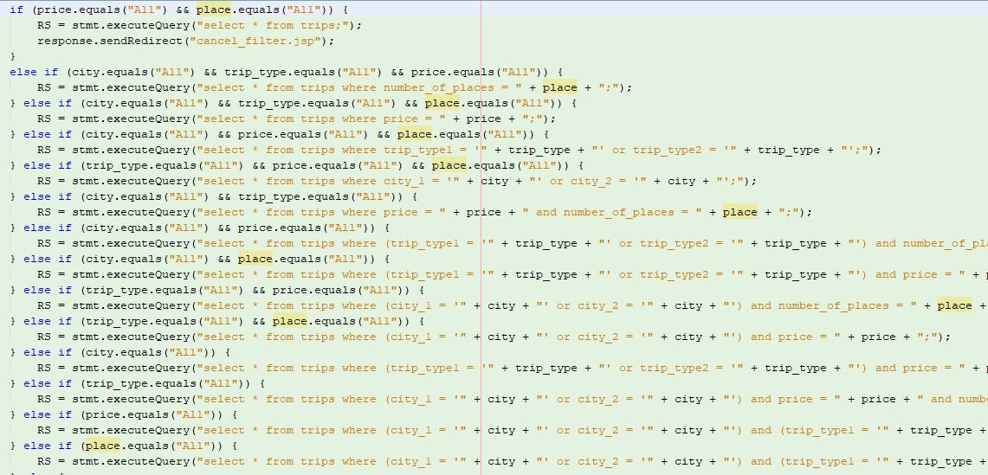

Slide 44
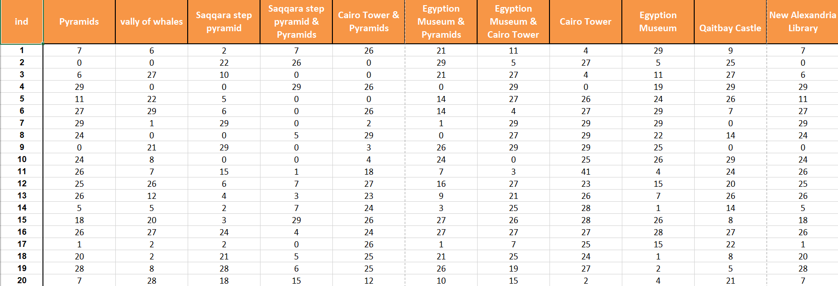
Future work
1- Its supposed that users will have an account “profile” on the website and according to them
trips history rates and interactions they will receive a notification with a recommended trips.
2- We used “OR technique” preference map to analyze this point:

Slide 45
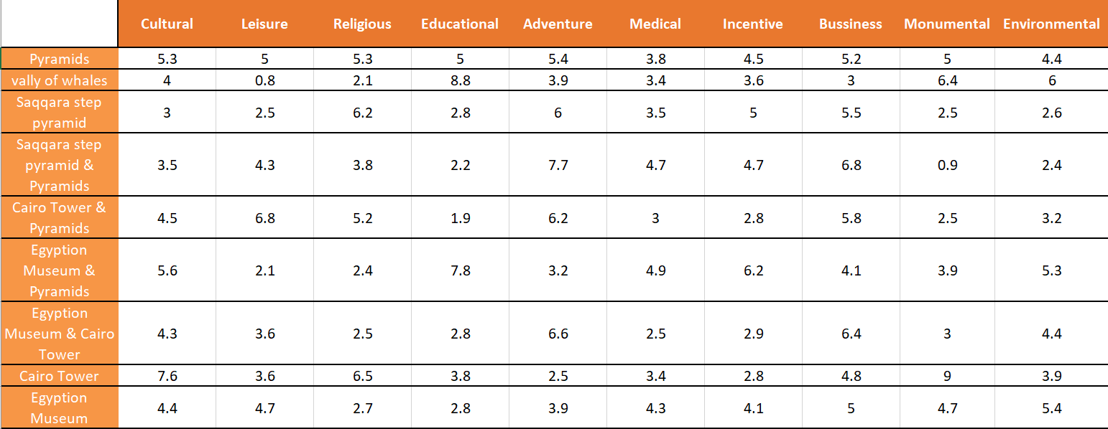
Preference map conts.

Slide 46
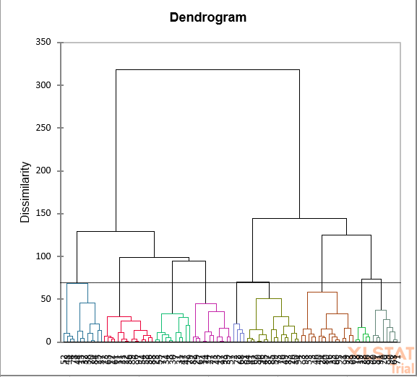
Preference map conts.

Slide 47
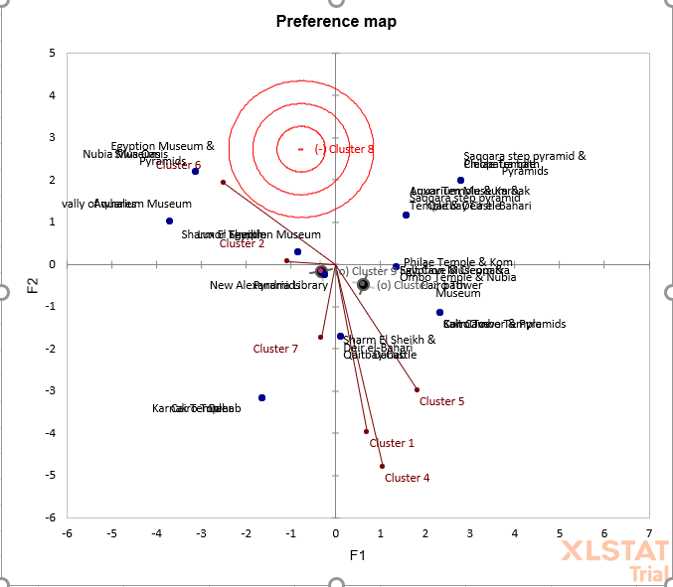
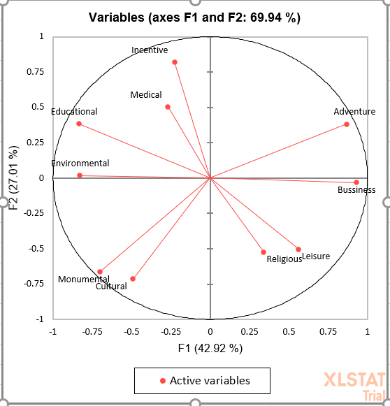
Preference map conts.

Slide 48
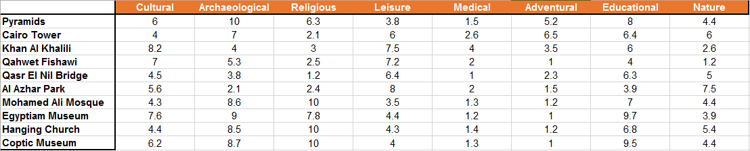
Preference map for form

Slide 49
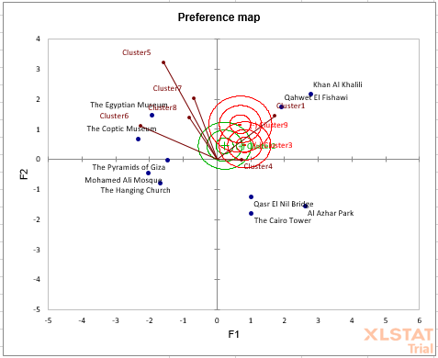

Preference map for form conts.

Slide 50


Conclusions
As shown at previous slides we website now is ready to use.
We aim it ”website” befits the great events that taking place in Egypt in Current period at tourism sector
-Parade of Mummies to The Museum of Egyptian
Civilization in Fustat.
-Capitals Museum in the new administrative capital.
we expect that website will be editable to satisfy demands of users “visitors” ,adding new features which make trips and usage of the system much easier.

Slide 51

Thanks for your listening, you could tell us if you have any questions.

